Slide 1
Data Structure and Algorithms
Prepared By: Afifa Hameed

Slide 2
Agenda
Overview of Lists, Interfaces, and Arrays.
Common operations (Insert, Delete, Traverse, Search) with complexity analysis.
Differences between static and dynamic arrays.
Practical applications using ArrayLists.

Slide 3
Why is this important?
Lists and Arrays are fundamental data structures in Java.
Efficient data storage and manipulation are crucial for software development.
Used extensively in problem-solving and real-world applications.

Slide 4
What is a List?
An ordered collection that allows duplicate elements.
Implemented using ArrayList, LinkedList, Vector, etc.
Provides flexibility compared to arrays.
Part of the Java Collections Framework.

Slide 5
What is an Interface?
Defines a contract for classes to implement.
Ensures abstraction and reusability.
Used in Java Collections (List, Set, Map).

Slide 6
Common Implementations of List Interface
ArrayList | Resizable array, fast random access, slow insert/delete at middle | ArrayList
LinkedList | Doubly linked list, fast insert/delete, slow random access | LinkedList
Vector | Similar to ArrayList, but synchronized | Vector

Slide 7
Using List Interface with ArrayList
import java.util.List;
import java.util.ArrayList;
public class ListExample {
public static void main(String[] args) {
List<String> names = new ArrayList<>();
names.add("Ali");
names.add(“Ahmed");
names.add(“Hassan");
for (String name : names)
{ System.out.println(name);
}
}
}

Slide 8
Implementing Custom Interface
interface Animal {
void makeSound();
}
class Dog implements Animal {
public void makeSound() {
System.out.println("Bark"); }}
public class InterfaceExample {
public static void main(String[] args) {
Animal myDog = new Dog();
myDog.makeSound(); // Output: Bark
}
}

Slide 9
Basics of Arrays and Array List
What is an Array?
Fixed-size data structure.
Stores elements of the same type.
Uses contiguous memory locations.
What is an ArrayList?
A resizable array implementation in Java.
Provides dynamic memory allocation.
Part of the java.util package.

Slide 10
Difference between Array and ArrayList
// Array (Static Size)
int[] numbers = new int[5];
numbers[0] = 10;
// ArrayList (Dynamic Size)
ArrayList<Integer> list = new ArrayList<>();
list.add(10);

Slide 11
Common Operations and Complexity Analysis
Operation | Static Array | ArrayList
Insert at End | O(1) | O(1) (Amortized)
Insert at Middle | O(N) | O(N)
Delete at End | O(1) | O(1)
Delete at Middle | O(N) | O(N)

Slide 12
ArrayList Example
ArrayList<Integer> numbers = new ArrayList<>();
numbers.add(1);
numbers.add(2);
numbers.add(3);
numbers.add(1, 10); // Inserts 10 at index 1
System.out.println(numbers); // Output: [1, 10, 2, 3]

Slide 13
Common Array Operations
Traversal: Iterating over elements.
int[] arr = {5, 10, 15, 20};
for (int num : arr)
{
System.out.print(num + " ");
}

Slide 14
Common Array Operations
Searching: Linear and Binary Search.
int search(int[] arr, int key)
{
for (int i = 0; i < arr.length; i++)
{
if (arr[i] == key) return i;
}
return -1;
}

Slide 15
ArrayList of primitives?
The type you specify when creating an ArrayList must be an object type; it cannot be a primitive type.
// illegal -- int cannot be a type parameter
ArrayList<int> list = new ArrayList<int>();
But we can still use ArrayList with primitive types by using special classes called wrapper classes in their place.
// creates a list of ints
ArrayList<Integer> list = new ArrayList<Integer>();

Slide 16
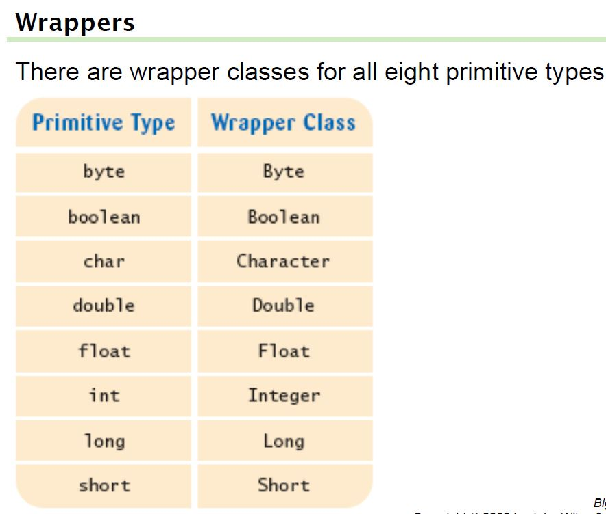
Wrapper classes

Slide 17
Wrapper classes
A wrapper is an object whose sole purpose is to hold a primitive value.
Once you construct the list, use it with primitives as normal:
ArrayList<Double> grades = new ArrayList<Double>();
grades.add(3.2);
grades.add(2.7);
...
double myGrade = grades.get(0);

Slide 18
Auto-Boxing
Auto-boxing: Automatic conversion between primitive types
and the corresponding wrapper classes:
Double d = 29.95; // auto-boxing; same as
// Double d = new Double(29.95);
double x = d; // auto-unboxing; same as
// double x = d.doubleValue();
Auto-boxing even works inside arithmetic expressions:
d = d + 1;
Means:
auto-unbox d into a double
add 1
auto-box the result into a new Double
store a reference to the newly created wrapper object in d

Slide 19
Static vs. Dynamic Arrays
Static Arrays:
Fixed size, efficient memory allocation.
Faster access time (O(1)).
Example: int[] arr = new int[10];
Dynamic Arrays (ArrayList):
Resizable and grows as needed.
Slight overhead due to resizing.
Example: ArrayList<Integer> list = new ArrayList<>();

Slide 20
Practical Application – E-commerce Inventory System
Scenario:
Managing product inventory using ArrayList.
Each product has a name and price.

Slide 21
Product Management
import java.util.ArrayList;
class Product {
String name;
double price;
Product(String name, double price)
{ this.name = name;
this.price = price; }}
public class Inventory
{ public static void main(String[] args)
{ ArrayList<Product> inventory = new ArrayList<>();
inventory.add(new Product("Laptop", 1200));
inventory.add(new Product("Phone", 800));
for (Product p : inventory)
{ System.out.println(p.name + " - $" + p.price);
} }}

Slide 22
Case Study: E-commerce Inventory System
Case Study: E-commerce Inventory System
How can we optimize inventory management?
When should we use an ArrayList instead of an array?

Slide 23
When to Use an ArrayList Instead of an Array?
Criteria | Array | ArrayList
Size | Fixed | Dynamic (resizable)
Performance | Fast random access (O(1)) | Slight overhead due to resizing
Insert/Delete | Slow (O(N) for middle elements) | Faster than arrays for end insertions (Amortized O(1))
Use Case | Best for static datasets | Best for dynamic datasets (e.g., inventory management)

Slide 24
Case Study: E-commerce Inventory System
Questions:
What are the trade-offs between static and dynamic arrays?
How would resizing affect performance?
Can we implement sorting and searching efficiently in an inventory system?

Slide 25
Summary
Arrays are crucial for efficient data handling.
Time complexity impacts performance choices.
Static vs. Dynamic arrays: Use based on constraints

